Slide 1
Probability Densities in Data Mining
Note to other teachers and users of these slides. Andrew would be delighted if you found this source material useful in giving your own lectures. Feel free to use these slides verbatim, or to modify them to fit your own needs. PowerPoint originals are available. If you make use of a significant portion of these slides in your own lecture, please include this message, or the following link to the source repository of Andrew’s tutorials: http://www.cs.cmu.edu/~awm/tutorials . Comments and corrections gratefully received.
Andrew W. Moore Professor
School of Computer Science Carnegie Mellon University
www.cs.cmu.edu/~awm awm@cs.cmu.edu
412-268-7599
Copyright © Andrew W. Moore
Slide 1
Probability Densities in Data Mining
Why we should care
Notation and Fundamentals of continuous PDFs
Multivariate continuous PDFs
Combining continuous and discrete random variables
Copyright © Andrew W. Moore
Slide 2

Slide 2
Why we should care
Real Numbers occur in at least 50% of database records
Can’t always quantize them
So need to understand how to describe where they come from
A great way of saying what’s a reasonable range of values
A great way of saying how multiple attributes should reasonably co-occur
Copyright © Andrew W. Moore
Slide 3
Why we should care
Can immediately get us Bayes Classifiers that are sensible with real-valued data
You’ll need to intimately understand PDFs in order to do kernel methods, clustering with Mixture Models, analysis of variance, time series and many other things
Will introduce us to linear and non-linear regression
Copyright © Andrew W. Moore
Slide 4

Slide 3
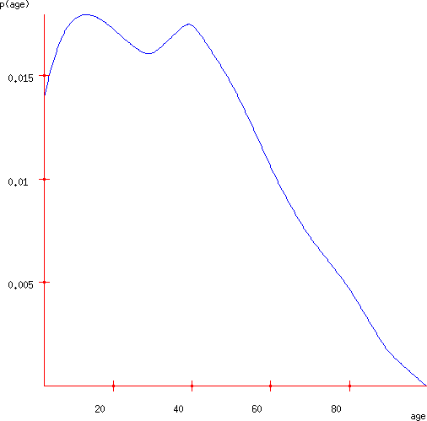
A PDF of American Ages in 2000
Copyright © Andrew W. Moore
Slide 5
A PDF of American Ages in 2000
Let X be a continuous random variable.
If p(x) is a Probability Density Function for X then…
P(a < X ≤ b) = ∫ p(x)dx
x=a
b
P(30 < Age ≤ 50) = ∫ p(age)dage
age=30
50
= 0.36
Copyright © Andrew W. Moore
Slide 6

Slide 4
Properties of PDFs
P(a < X ≤ b) = ∫ p(x)dx
x=a
That means…
b
P⎛ x − ^{h} < X ≤ x + ^{h ⎞}
⎜ ₂ ⎟
p(x) = _{lim}
⎝
2
⎠
h→0
h
∂ P(X ≤ x) = p(x)
∂x
Copyright © Andrew W. Moore
Slide 7
Properties of PDFs
P(a < X ≤ b) = ∫ p(x)dx
x=a
b
Therefore…
∞
∫ p(x)dx = 1
x=−∞
∂ P(X ≤ x) = p(x)
Therefore… ∀x : p(x) ≥ 0
Copyright © Andrew W. Moore
∂x
Slide 8

Slide 5
Talking to your stomach
What’s the gut-feel meaning of p(x)?
If
p(5.31) = 0.06 and p(5.92) = 0.03
then
when a value X is sampled from the distribution, you are 2 times as likely to find that X is “very close to” 5.31 than that X is “very close to” 5.92.
Copyright © Andrew W. Moore
Slide 9
Talking to your stomach
What’s the gut-feel meaning of p(x)?
If
p( a ) = 0.06 and p( b ) = 0.03
then
when a value X is sampled from the distribution, you are 2 times as likely to find
a
that X is “very close to” than that X is “very close to” b .
Copyright © Andrew W. Moore
Slide 10

Slide 6
Talking to your stomach
What’s the gut-feel meaning of p(x)?
If
p( a ) = 2z and p( b ) = z
then
when a value X is sampled from the distribution, you are 2 times as likely to find
a
that X is “very close to” than that X is “very close to” b .
Copyright © Andrew W. Moore
Slide 11
Talking to your stomach
What’s the gut-feel meaning of p(x)?
If
p( a ) = αz and p( b ) = z
then
when a value X is sampled from the distribution, you are α times as likely to find
a
that X is “very close to” than that X is “very close to” b .
Copyright © Andrew W. Moore
Slide 12

Slide 7
Talking to your stomach
What’s the gut-feel meaning of p(x)?
If
p(a) _{= α}
p(b)
then
when a value X is sampled from the distribution, you are α times as likely to find
a
that X is “very close to” than that X is “very close to” ^{b} .
Copyright © Andrew W. Moore
Slide 13
Talking to your stomach
What’s the gut-feel meaning of p(x)?
If
p(a) _{= α}
p(b)
then
_{lim} P(a − h < X < a + h) _{= α}
^{h→0} P(b − h < X < b + h)
Copyright © Andrew W. Moore
Slide 14

Slide 8
Yet another way to view a PDF
A recipe for sampling a random age.
Generate a random dot from the rectangle surrounding the PDF curve. Call the dot (age,d)
If d < p(age) stop and return age
Else try again: go to Step 1.
Copyright © Andrew W. Moore
Slide 15
Test your understanding
True or False:
∀x : p(x) ≤ 1
∀x : P( X = x) = 0
Copyright © Andrew W. Moore
Slide 16

Slide 9
Expectations
E[X] = the expected value of random variable X
= the average value we’d see if we took a very large number of random samples of X
∞
= ∫ x p(x) dx
x=−∞
Copyright © Andrew W. Moore
Slide 17
Expectations
E[X] = the expected value of random variable X
= the average value we’d see if we took a very large number of random samples of X
∞
= ∫ x p(x) dx
x=−∞
= the first moment of the shape formed by the axes and the blue curve
= the best value to choose if you must guess an unknown person’s age and you’ll be fined the square of your error
E[age]=35.897
Copyright © Andrew W. Moore
Slide 18

Slide 10
Expectation of a function
μ=E[f(X)] = the expected value of f(x) where x is drawn from X’s distribution.
= the average value we’d see if we took a very large number of random samples of f(X)
∞
μ = ∫ f (x) p(x) dx
x=−∞
E[age² ] = 1786.64
(E[age])² = 1288.62
Note that in general:
E[ f (x)] ≠ f (E[ X ])
Copyright © Andrew W. Moore
Slide 19
Variance
σ² = Var[X] = the expected squared difference between x and E[X]
σ ² = ∫ (x − μ )² p(x) dx
x=−∞
= amount you’d expect to lose if you must guess an unknown person’s age and you’ll be fined the square of your error, and assuming you play optimally
∞
Var[age] = 498.02
Copyright © Andrew W. Moore
Slide 20

Slide 11
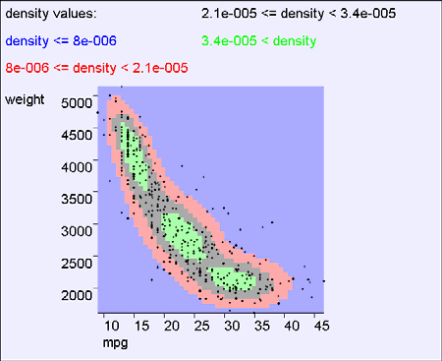
Standard Deviation
σ² = Var[X] = the expected squared
difference between x and E[X]
Var[age] = 498.02
σ = 22.32
∞
σ ² = ∫ (x − μ )² p(x) dx
x=−∞
= amount you’d expect to lose if you must guess an unknown person’s age and you’ll be fined the square of your error, and assuming you play optimally
σ = Standard Deviation = “typical” deviation of X from its mean
σ = Var[ X ]
Copyright © Andrew W. Moore
Slide 21
In 2 dimensions
p(x,y) = probability density of random variables (X,Y) at location (x,y)
Copyright © Andrew W. Moore
Slide 22

Slide 12
In 2 dimensions
Let X,Y be a pair of continuous random variables, and let R be some region of (X,Y) space…
P(( X ,Y ) ∈ R) = ∫∫ p(x, y)dydx
( x, y )∈R
Copyright © Andrew W. Moore Slide 23
In 2 dimensions
Let X,Y be a pair of continuous random variables, and let R be some region of (X,Y) space…
P(( X ,Y ) ∈ R) = ∫∫ p(x, y)dydx
( x, y )∈R
P( 20<mpg<30 and 2500<weight<3000) =
area under the 2-d surface within the red rectangle
Copyright © Andrew W. Moore
Slide 24

Slide 13
In 2 dimensions
Let X,Y be a pair of continuous random variables, and let R be some region of (X,Y) space…
P(( X ,Y ) ∈ R) = ∫∫ p(x, y)dydx
( x, y )∈R
P( [(mpg-25)/10]² +
[(weight-3300)/1500]²
< 1 ) =
area under the 2-d surface within the red oval
Copyright © Andrew W. Moore
Slide 25
In 2 dimensions
Let X,Y be a pair of continuous random variables, and let R be some region of (X,Y) space…
P(( X ,Y ) ∈ R) = ∫∫ p(x, y)dydx
( x, y )∈R
Take the special case of region R = “everywhere”.
Remember that with probability 1, (X,Y) will be drawn from “somewhere”.
So..
∞ ∞
∫
∫ p(x, y)dydx = 1
x=−∞ y=−∞
Copyright © Andrew W. Moore
Slide 26

Slide 14
In 2 dimensions
Let X,Y be a pair of continuous random variables, and let R be some region of (X,Y) space…
P(( X ,Y ) ∈ R) = ∫∫ p(x, y)dydx
( x, y )∈R
p(x, y) =
P⎛ x − ^{h} < X ≤ x + ^{h}
∧ y − ^{h} < Y ≤ y + ^{h ⎞}
_{h}2
⎜
2 2
2
₂ ⎟
lim
⎝
⎠
h→0
Copyright © Andrew W. Moore
Slide 27
In m dimensions
Let (X₁,X₂,…X_{m}) be an n-tuple of continuous random variables, and let R be some region of R^{m} …
P(( X₁, X ₂ ,..., X_{m} ) ∈ R) =
∫∫...∫ p(x₁ , x₂ ,..., x_{m} )dx_{m} , ,...dx₂ , dx₁
( x₁ , x₂ ,...,x_{m} )∈R
Copyright © Andrew W. Moore
Slide 28

Slide 15
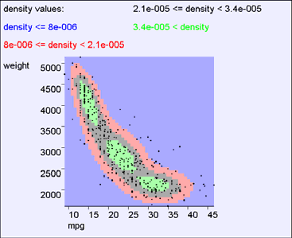
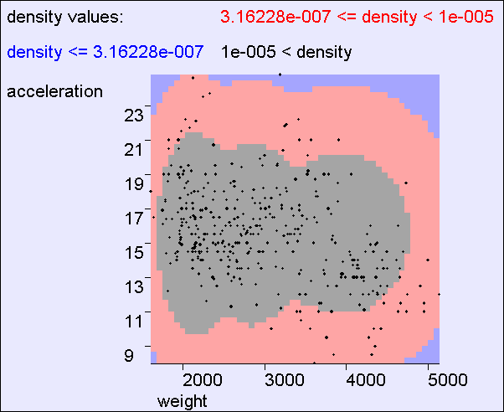
Independence
X ⊥ Y iff ∀x, y : p( x, y) = p(x) p( y)
If X and Y are independent then knowing the value of X does not help predict the value of Y
mpg,weight NOT independent
Copyright © Andrew W. Moore
Slide 29
Independence
X ⊥ Y iff ∀x, y : p( x, y) = p(x) p( y)
If X and Y are independent then knowing the value of X does not help predict the value of Y
the contours say that acceleration and weight are independent
Copyright © Andrew W. Moore
Slide 30

Slide 16

Multivariate Expectation
μ_{X} = E[X] = ∫ x p(x)dx
E[mpg,weight] = (24.5,2600)
The centroid of the cloud
Copyright © Andrew W. Moore
Slide 31
Multivariate Expectation
E[ f (X)] = ∫ f (x) p(x)dx
Copyright © Andrew W. Moore
Slide 32

Slide 17
Test your understanding
Question : When (if ever) does E[ X + Y ] = E[ X ] + E[Y ]?
•All the time?
•Only when X and Y are independent?
•It can fail even if X and Y are independent?
Copyright © Andrew W. Moore
Slide 33
Bivariate Expectation
E[ f (x, y)] = ∫ f (x, y) p(x, y)dydx
if f ( x, y) = x then E[ f ( X ,Y )] = ∫ x p(x, y)dydx
if f ( x, y) = y then E[ f ( X ,Y )] = ∫ y p(x, y)dydx
if f ( x, y) = x + y then E[ f ( X ,Y )] = ∫ (x + y) p(x, y)dydx
E[ X + Y ] = E[ X ] + E[Y ]
Copyright © Andrew W. Moore
Slide 34

Slide 18
Bivariate Covariance
σ _{xy} = Cov[X ,Y ] = E[( X − μ_{x} )(Y − μ _{y} )]
2 2
σ _{xx} = σ x = Cov[X , X ] = Var[ X ] = E[( X − μ ) ]
x
σ _{yy} = σ = Cov[Y ,Y ] = Var[Y ] = E[(Y − μ ) ]
2 2
y
y
Copyright © Andrew W. Moore
Slide 35
Bivariate Covariance
σ _{xy} = Cov[X ,Y ] = E[( X − μ_{x} )(Y − μ _{y} )]
σ _{xx} = σ = Cov[X , X ] = Var[ X ] = E[( X − μ ) ]
2 2
x
x
σ _{yy} = σ
2
= Cov[Y ,Y ] = Var[Y ] = E[(Y − μ ) ]
y
y
2
Write X = ^{⎛ X ⎞} , then
⎜ ⎟
⎝ ^{Y} ⎠
⎛σ ² x
σ
⎞
T
⎜
xy
⎟
Cov[ X] = E[(X − μ )(X − μ ) ] = Σ =
⎜ _{σ}
⎟
x x
⎝
xy
σ ² y
⎠
Copyright © Andrew W. Moore
Slide 36

Slide 19
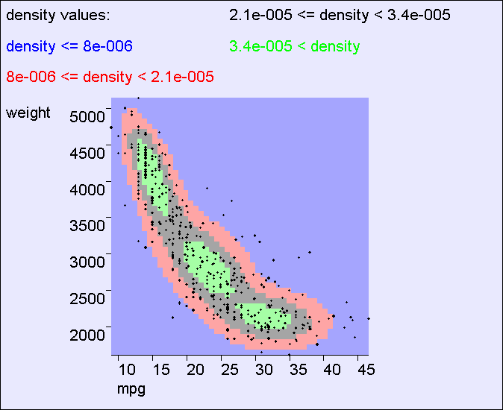
Covariance Intuition
E[mpg,weight] = (24.5,2600)
^{σ} weight ⁼ ⁷⁰⁰
^{σ} weight ⁼ ⁷⁰⁰
σ _{mpg} = 8 σ _{mpg} = 8
Copyright © Andrew W. Moore
Slide 37
Covariance Intuition
Principal Eigenvector of Σ
E[mpg,weight] = (24.5,2600)
^{σ} weight ⁼ ⁷⁰⁰
^{σ} weight ⁼ ⁷⁰⁰
σ _{mpg} = 8 σ _{mpg} = 8
Copyright © Andrew W. Moore
Slide 38

Slide 20
Covariance Fun Facts
⎛σ ² x
σ
⎞
T
⎜
xy ⎟
Cov[ X] = E[(X − μ )(X − μ ) ] = Σ =
⎜ _{σ}
x x
⎝
σ ² y ⎟
•True or False: If σ_{xy} = 0 then X and Y are independent
•True or False: If X and Y are independent then σ_{xy} = 0
•True or False: If σ_{xy} = σ_{x} σ_{y} then X and Y are deterministically related
•True or False: If X and Y are deterministically related then σ_{xy} = σ_{x} σ_{y}
xy
⎠
How could you prove or disprove these?
Copyright © Andrew W. Moore
Slide 39
General Covariance
Let X = (X₁,X₂, … X_{k}) be a vector of k continuous random variables
T
Cov[ X] = E[(X − μ )(X − μ ) ] = Σ
x x
Σ_{ij} = Cov[ X_{i} , X _{j} ] = σ
x x
i j
S is a k x k symmetric non-negative definite matrix
If all distributions are linearly independent it is positive definite
If the distributions are linearly dependent it has determinant zero
Copyright © Andrew W. Moore
Slide 40

Slide 21
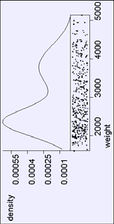
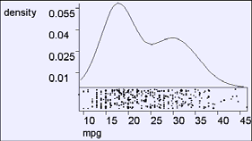
Test your understanding
Question : When (if ever) does Var[ X + Y ] = Var[ X ] +Var[Y ]?
•All the time?
•Only when X and Y are independent?
•It can fail even if X and Y are independent?
Copyright © Andrew W. Moore
Slide 41
Marginal Distributions
∞
p(x) = ∫ p(x, y)dy
y =−∞
Copyright © Andrew W. Moore
Slide 42

Slide 22
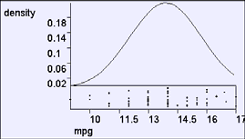

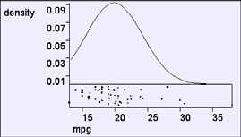
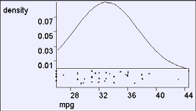
Conditional
p(mpg | weight = 4600)
Distributions
p(mpg | weight = 3200)
p(mpg | weight = 2000)
p(x | y) =
p.d.f. of X when Y = y
Copyright © Andrew W. Moore
Slide 43
p(mpg | weight = 4600)
Conditional
Distributions
p(x | y) = ^{p(x, y)}
p( y)
Why?
p(x | y) =
p.d.f. of X when Y = y
Copyright © Andrew W. Moore
Slide 44

Slide 23
Independence Revisited
X ⊥ Y iff ∀x, y : p( x, y) = p(x) p( y)
It’s easy to prove that these statements are equivalent…
∀x, y : p( x, y) = p(x) p( y)
⇔
∀x, y : p( x | y) = p(x)
⇔
∀x, y : p( y | x) = p( y)
Copyright © Andrew W. Moore Slide 45
∞
More useful stuff
∫ p(x | y)dx = 1
(These can all be proved from definitions on previous slides)
x=−∞
p(x | y, z) = ^{p(x, y | z)}
p( y | z)
_{p(x | y) =} p( y | x) p(x)
p( y)
Copyright © Andrew W. Moore
Bayes Rule
Slide 46

Slide 24
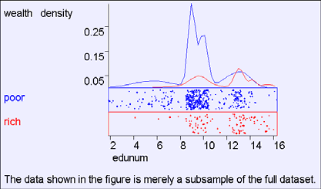
Mixing discrete and continuous variables
P⎛ x − ^{h} < X ≤ x + ^{h} ∧ A = v ⎞
⎜ ⎟
p(x, A = v) = _{lim}
⎝
2
2
⎠
h→0
h
∞
^{v=1} x=−∞
_{p(x | A) =} P( A | x) p(x)
P( A)
n_{A}
∑ ∫ p(x, A = v)dx = 1
Bayes Rule
_{P( A | x) =} p(x | A)P( A)
p(x)
Bayes Rule
Copyright © Andrew W. Moore
Slide 47
Mixing discrete and continuous variables
P(EduYears,Wealthy)
Copyright © Andrew W. Moore
Slide 48

Slide 25
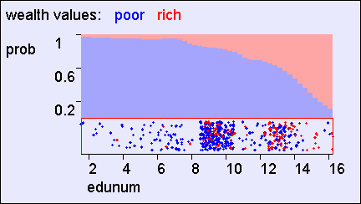

Mixing discrete and continuous variables
P(EduYears,Wealthy)
P(Wealthy| EduYears)
Copyright © Andrew W. Moore
Slide 49
Mixing discrete and continuous variables
P(EduYears,Wealthy)
P(Wealthy| EduYears)
P(EduYears|Wealthy)
Renormalized Axes
Copyright © Andrew W. Moore
Slide 50

Slide 26
What you should know
You should be able to play with discrete, continuous and mixed joint distributions
You should be happy with the difference between p(x) and P(A)
You should be intimate with expectations of continuous and discrete random variables
You should smile when you meet a covariance matrix
Independence and its consequences should be second nature
Copyright © Andrew W. Moore Slide 51
Discussion
Are PDFs the only sensible way to handle analysis of real-valued variables?
Why is covariance an important concept?
Suppose X and Y are independent real-valued random variables distributed between 0 and 1:
What is p[min(X,Y)]?
What is E[min(X,Y)]?
Prove that E[X] is the value u that minimizes
E[(X-u)²]
What is the value u that minimizes E[|X-u|]?
Copyright © Andrew W. Moore
Slide 52

